Slide 1

Learning center: Research,
take-aways, and MVP roadmap
August 2020
Public Website Team | Digital Experience Product Office
Product: Jennifer.lee27@va.gov Design: Ryan.Thurlwell@va.gov

Slide 2
Agenda
MVP roadmap
Problem statement
Summary of user research findings
Comparative analysis
Design and function

Slide 3
1. MVP 2020 roadmap

Slide 4
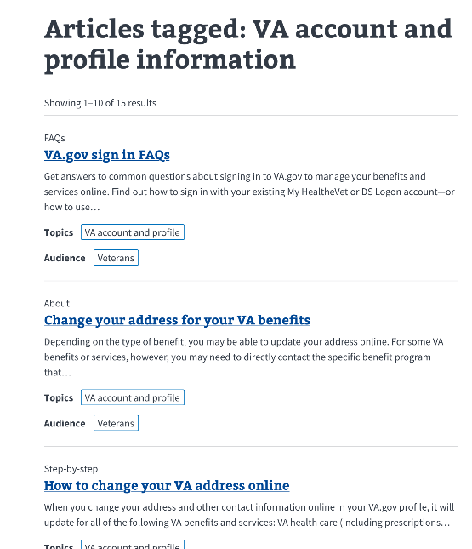
MVP 1.0 – Oct/Nov 2020
1.0 beta launching with:
1 audience type: All Veterans
2 categories:
VA account and profile
Other topics and questions
Templates for Oct launch:
LC homepage
LC search results + ‘view all X articles’ landing page
Multiple FAQs
Single Q&A
Step-by-step
About
Reusable FAQs infrastructure

Slide 5
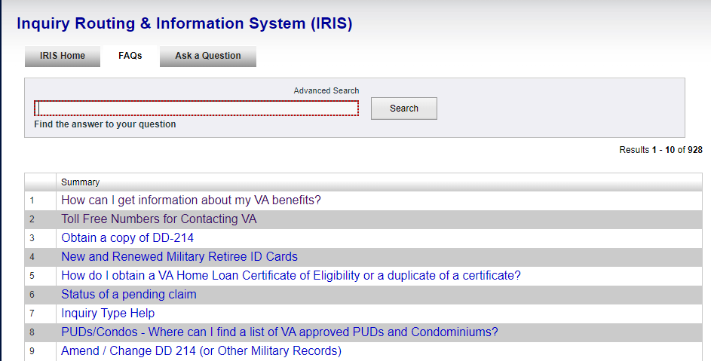
MVP 1.1 – End of December 2020
Finish manual migration of IRIS FAQs content
Additional audience and topic categories
Was this helpful component data integration with Google Analytics
Add to IA
Templates to add for Dec launch:
Videos template
Images template
Checklist
Template iteration:
LC homepage FE iteration – audience section, more topic categories

Slide 6
Things we’ll flesh out as we go
Card sort (in flight)
IRIS contact center authoring user research (starting)
OKRs, KPIs, and Analytics
Beta launch, hidden launch – What does ‘staging’ launch look like with Drupal content?
IA
Search configuration

Slide 7
2. Problem statement

Slide 8
Migrating all Veteran-facing benefit related content into benefit hubs is not scalable
Problem statement
How do we ensure that tier 2 benefit supporting info is accessible and helpful in the new VA.gov experience, but does not dilute and clutter tier 1 benefit hub top tasks?
As the content team has been ‘migrating’ Veteran-facing benefit information from legacy pages, we’re encountering more subtle gradations of content that’s not directly relevant to eligibility, applying, or managing benefits.
They are benefit related, but not directly about eligibility, applying, or managing. We conceptualized this type of content as tier 2 benefit-adjacent.
For more information about content tiers:
https://github.com/department-of-veterans-affairs/va.gov-team/blob/master/products/content/tier-2-content-IA-and-design/content-tiers-VA.gov.pdf

Slide 9
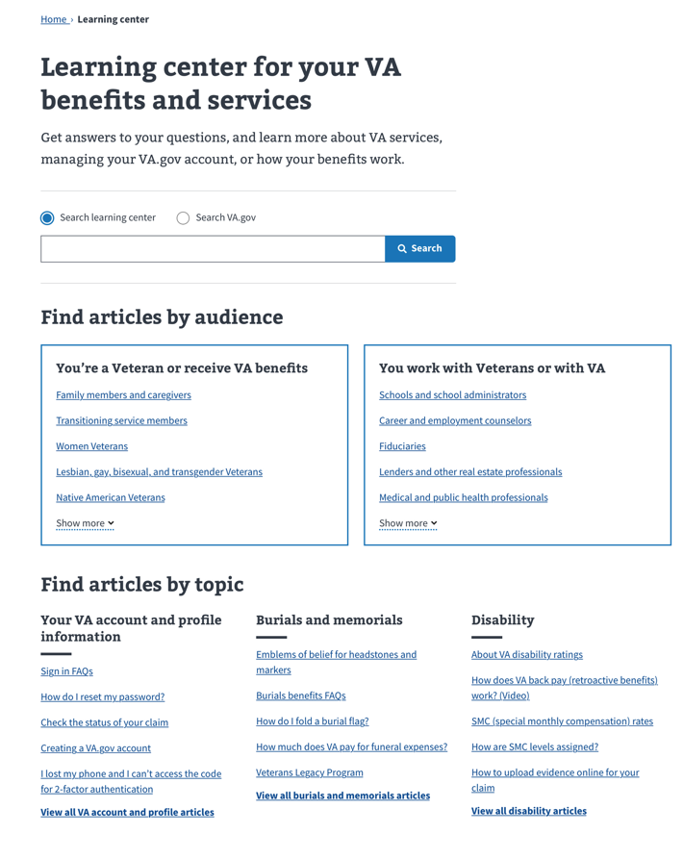
Optimize learning center for supporting, learning, exploring, problem-solving
Optimize learning center content for:
Answering benefit-adjacent support questions for veterans
Providing a space for audiences who support veterans, such as caregivers, school administrators, VSOs, VA loan appraisers, etc.
Helping customers self-resolve VA.gov issues that span benefits or that are agnostic of benefit issues.
Funnel customers to tier 1 benefit hubs for applying and managing.

Slide 10
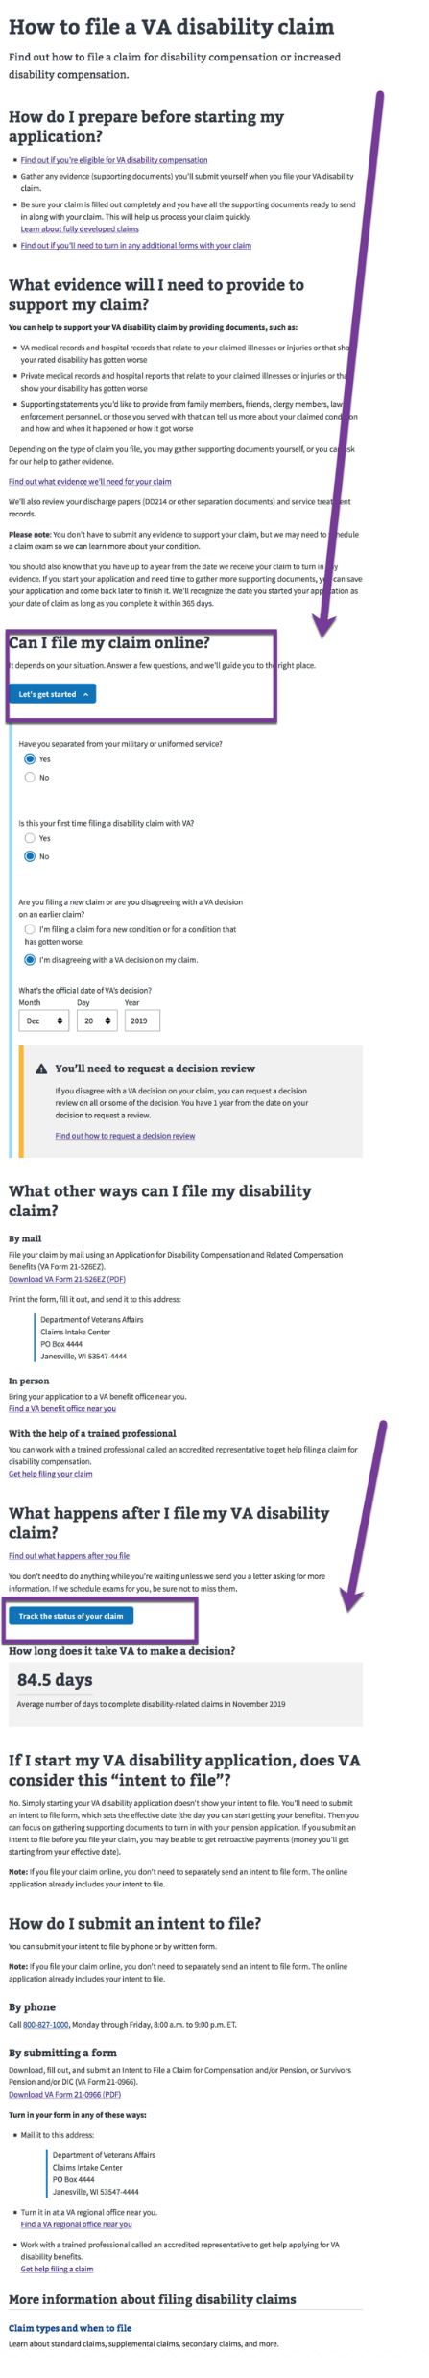
Optimize benefit hubs for applying and managing
Optimize benefit hub content for:
Applying, enrolling, filing, eligibility
Signing in to manage tasks
Creating a VA.gov account
All content – even tier 3 office content and VA ‘marketing’ efforts – will point to benefit hubs.
It will become more important to make the hubs optimized for conversion.

Slide 11
What kind of content belongs in the learning center?

Slide 12
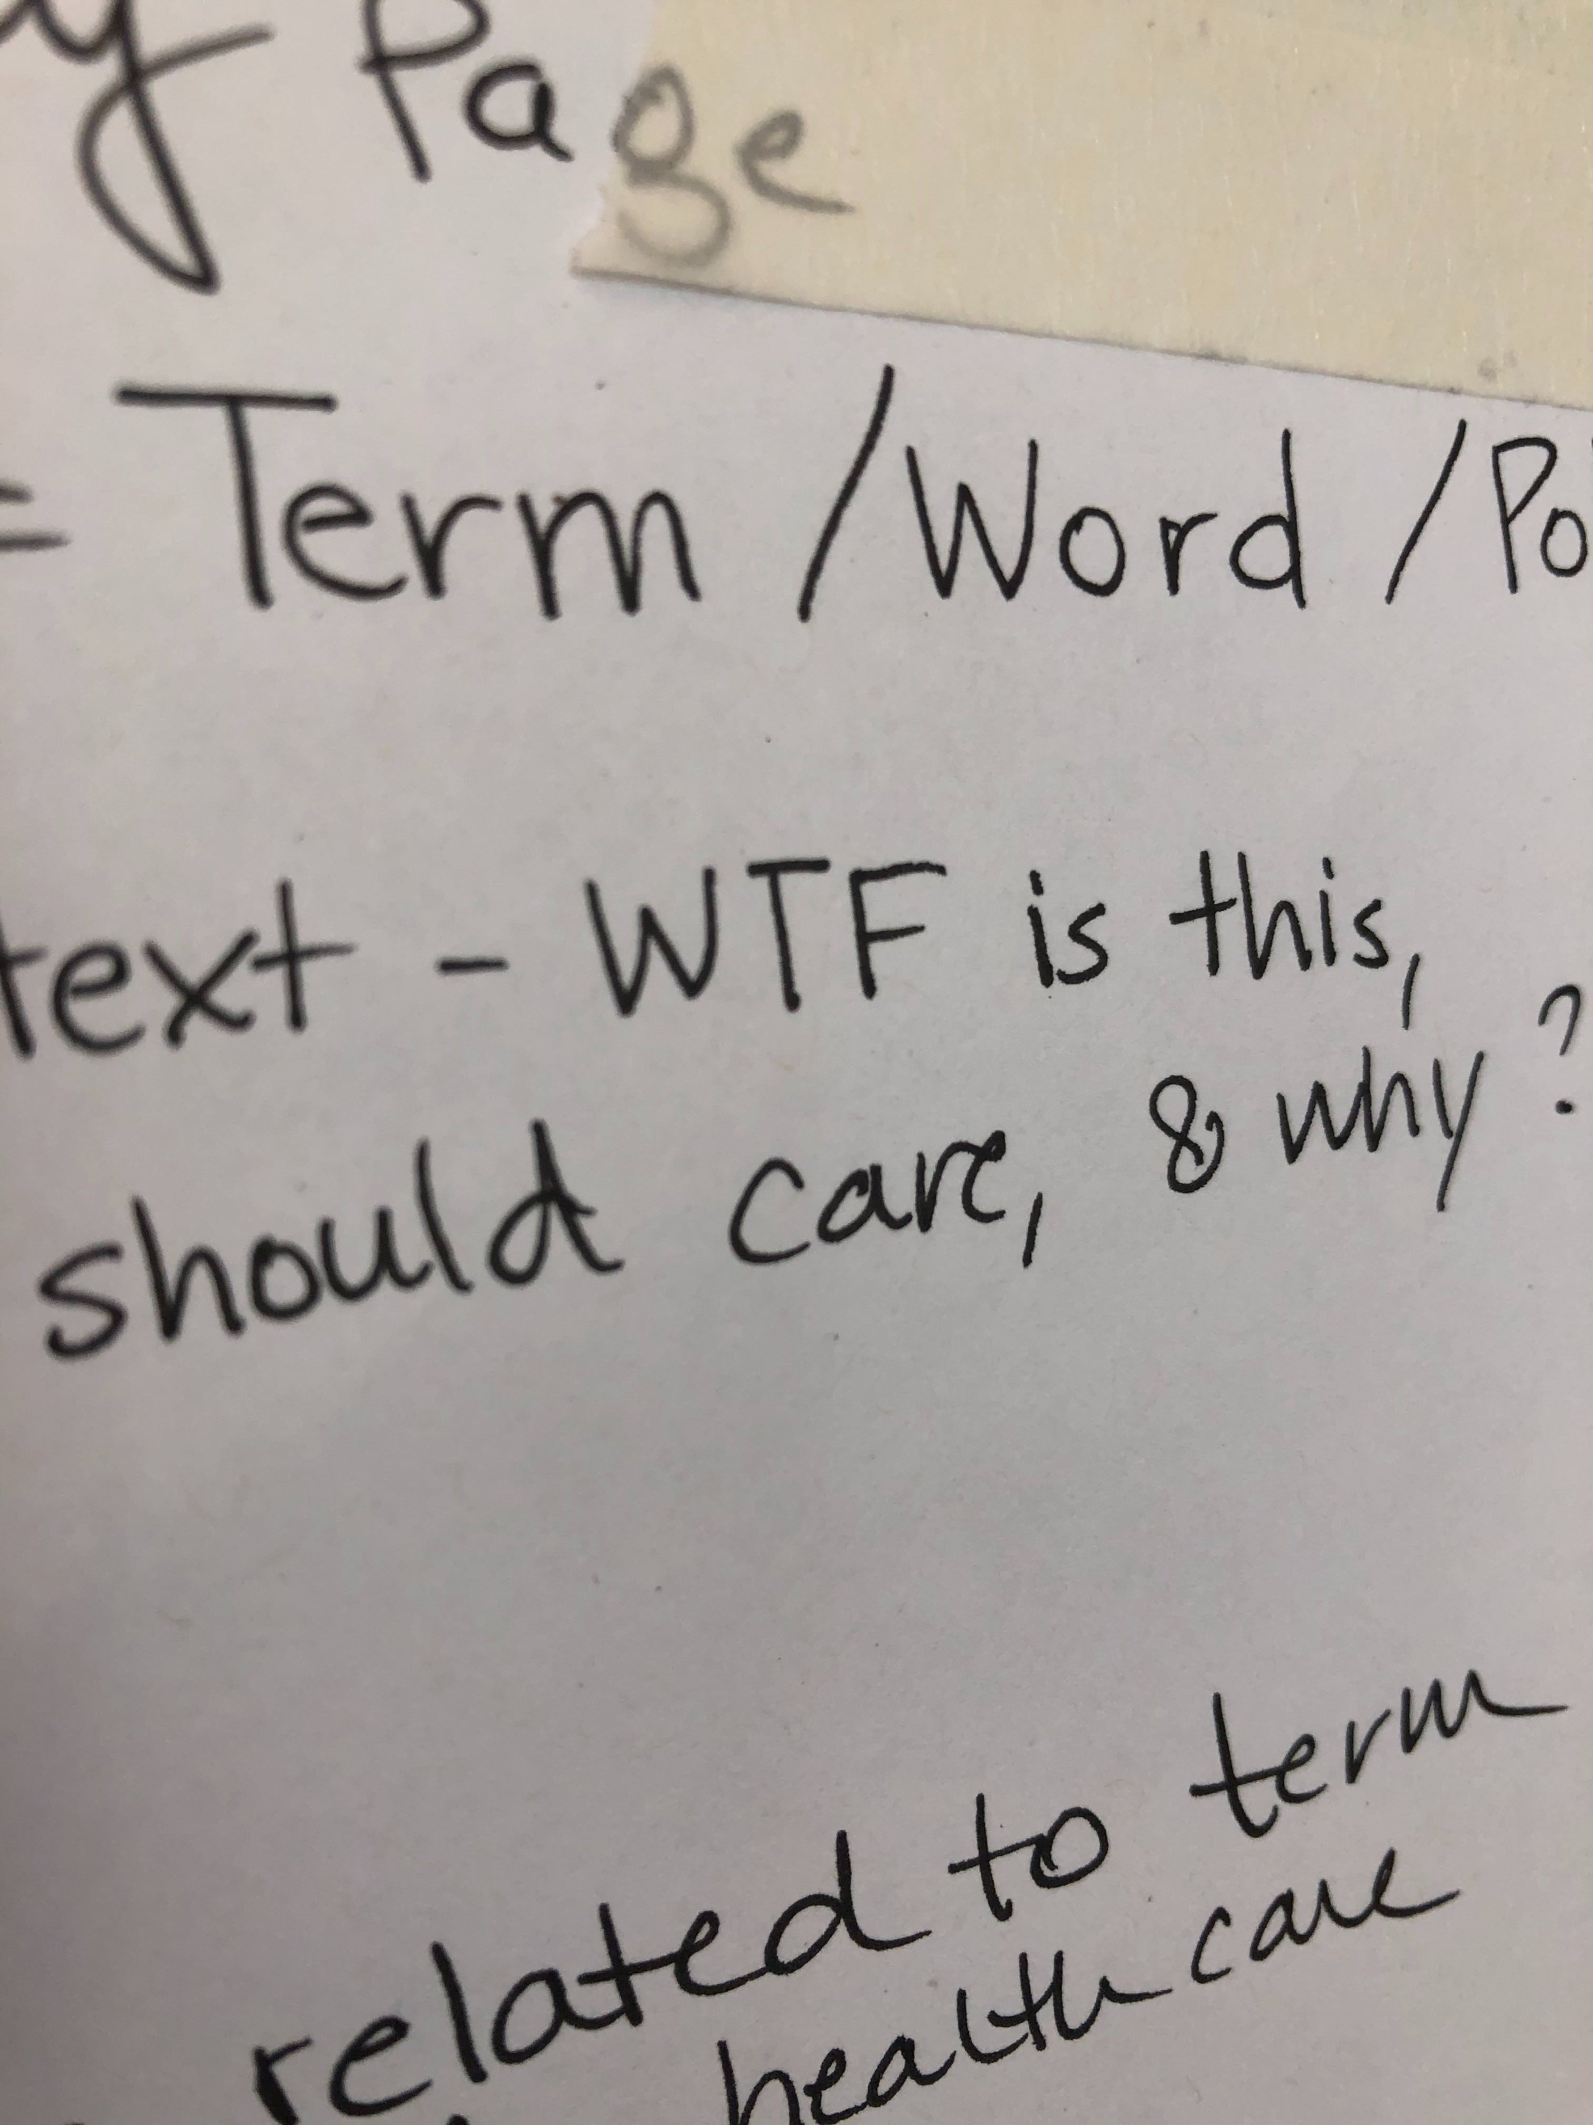
Tier 2 content is vast
It feels hard to grasp.
It feels blobby.
There’s a lot of gray areas.
It makes everyone a little bit nervous.
Breathe….

Slide 13
Tiers are conceptual
It’s not a 100% mirror-like reflection of reality.
It’s not meant to be.
It can take us part of the way to tackling big content problems.
We will embrace ambiguity and learn as we go!

Slide 14


Focus on the 80%.
Reality includes fuzziness. It’s okay.
We will be aware of--but not paralyzed by--the fuzzy borders.
Tier 1 benefit and tools
Fuzzy Space
80% zone
Tier 2 learning and support
Fuzzy Space
Tier 3 administration/program office
And other unknown below the iceberg content

Slide 15
What kind of content belongs in the learning center?
Examples of real legacy tier 2 LC content for beneficiaries
How to challenge a claims agent fee
VA services for Veterans in prison or who are about to be released
What if my school term was interrupted by a hurricane or natural disaster?

Slide 16
The hundreds of discrete, nichey questions Veterans may have…
What VA family member benefits are my same-sex spouse eligible for?
Checklist for scheduling a burial at a national cemetery
Forms for filing a life insurance claim for your deceased Veteran

Slide 17
Beyond eligibility and applying
Examples of real legacy tier 2 LC content for beneficiaries
Directory of state Veterans agencies
I lost my phone and I can’t access the code for 2-factor authentication
How to prepare for your Agent Orange Registry Health Exam
Checklist for preparing for your Agent Orange Registry Health Exam

Slide 18
Benefit-adjacent support information for people who support Veterans
Examples of real legacy tier 2 LC content for non-beneficiaries
How do I become a fiduciary for my Veteran friend or family member?
What is a VA appointed fiduciary responsible for?
What are the requirements to become a VA fee appraiser or inspector?
How to apply for VA accreditation as an attorney or claims agent
VA subsidies and other incentives for businesses to hire Veterans
NCA cemetery grants for states, tribal governments, and territories
VA resources for lenders and VA fee appraisers… and more

Slide 19
Dirty data: Content is similarly messy at VA
Like tier 1 Veteran-facing content, tier 2 content may be embedded and mixed up with other kinds of non-Veteran-facing information.
Some tier 2 content work, like tier 1 content parity, may need extracting beneficiary-facing information from legacy tier 3 office and program content
Some tier 2 learning content may need to be moved from the tier 1 benefit hubs.

Slide 20
3. Summary synthesis of usability test

Slide 21
Research questions
Is the information easy to find using this search-focused, tag-based navigation?
How easily are people able to navigate between learning center articles, and topics?
Are the template labels (ex: FAQs, Checklist, About, Step-by-step, etc.) useful?
What do people see as the difference between the learning center search and overall site search?
Do people get confused if they click on a content link or CTA button in the learning center and it takes them to a benefit hub page? And vice versa?
Do people understand that information they don't find in the learning center might be in the benefit hub?
Where would the most useful place be to provide links to the learning center?

Slide 22
“It [the layout] makes it very simple and easy for somebody to use, regardless of your age, or how you are associated with the military or the VA.”

Slide 23
Key Findings
The design of the learning center pages makes it easy to navigate and find information for most people.
The taxonomy seemed to match the mental models of our participants.
Template labels were helpful.
People experienced no confusion moving between a benefit hub page and a learning center page.
People assumed all benefit information would be available in the learning center.
Template labels were helpful for most people when reviewing a list of articles.
People understood the learning center search functionality, but not sure about VA.gov search.

Slide 24
Outcomes: Design updates and feature changes
Simplifying the search results page (omit intro)
Simplifying the search results listing (omit tags)
Making benefit and administration taxonomies backend only
Enabling backend category ‘tagging’ – one official home, but can be displayed in multiple categories
Flattening topic and audience tags; move to bottom layer
Creating a dedicated required section for a VA benefit hub
Simplifying contact us phone number displays based on default VA.gov help desk or most relevant benefit hub

Slide 25
4. Comparative analysis

Slide 26
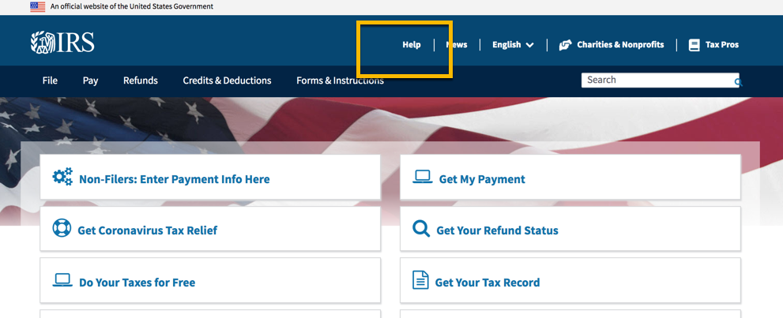
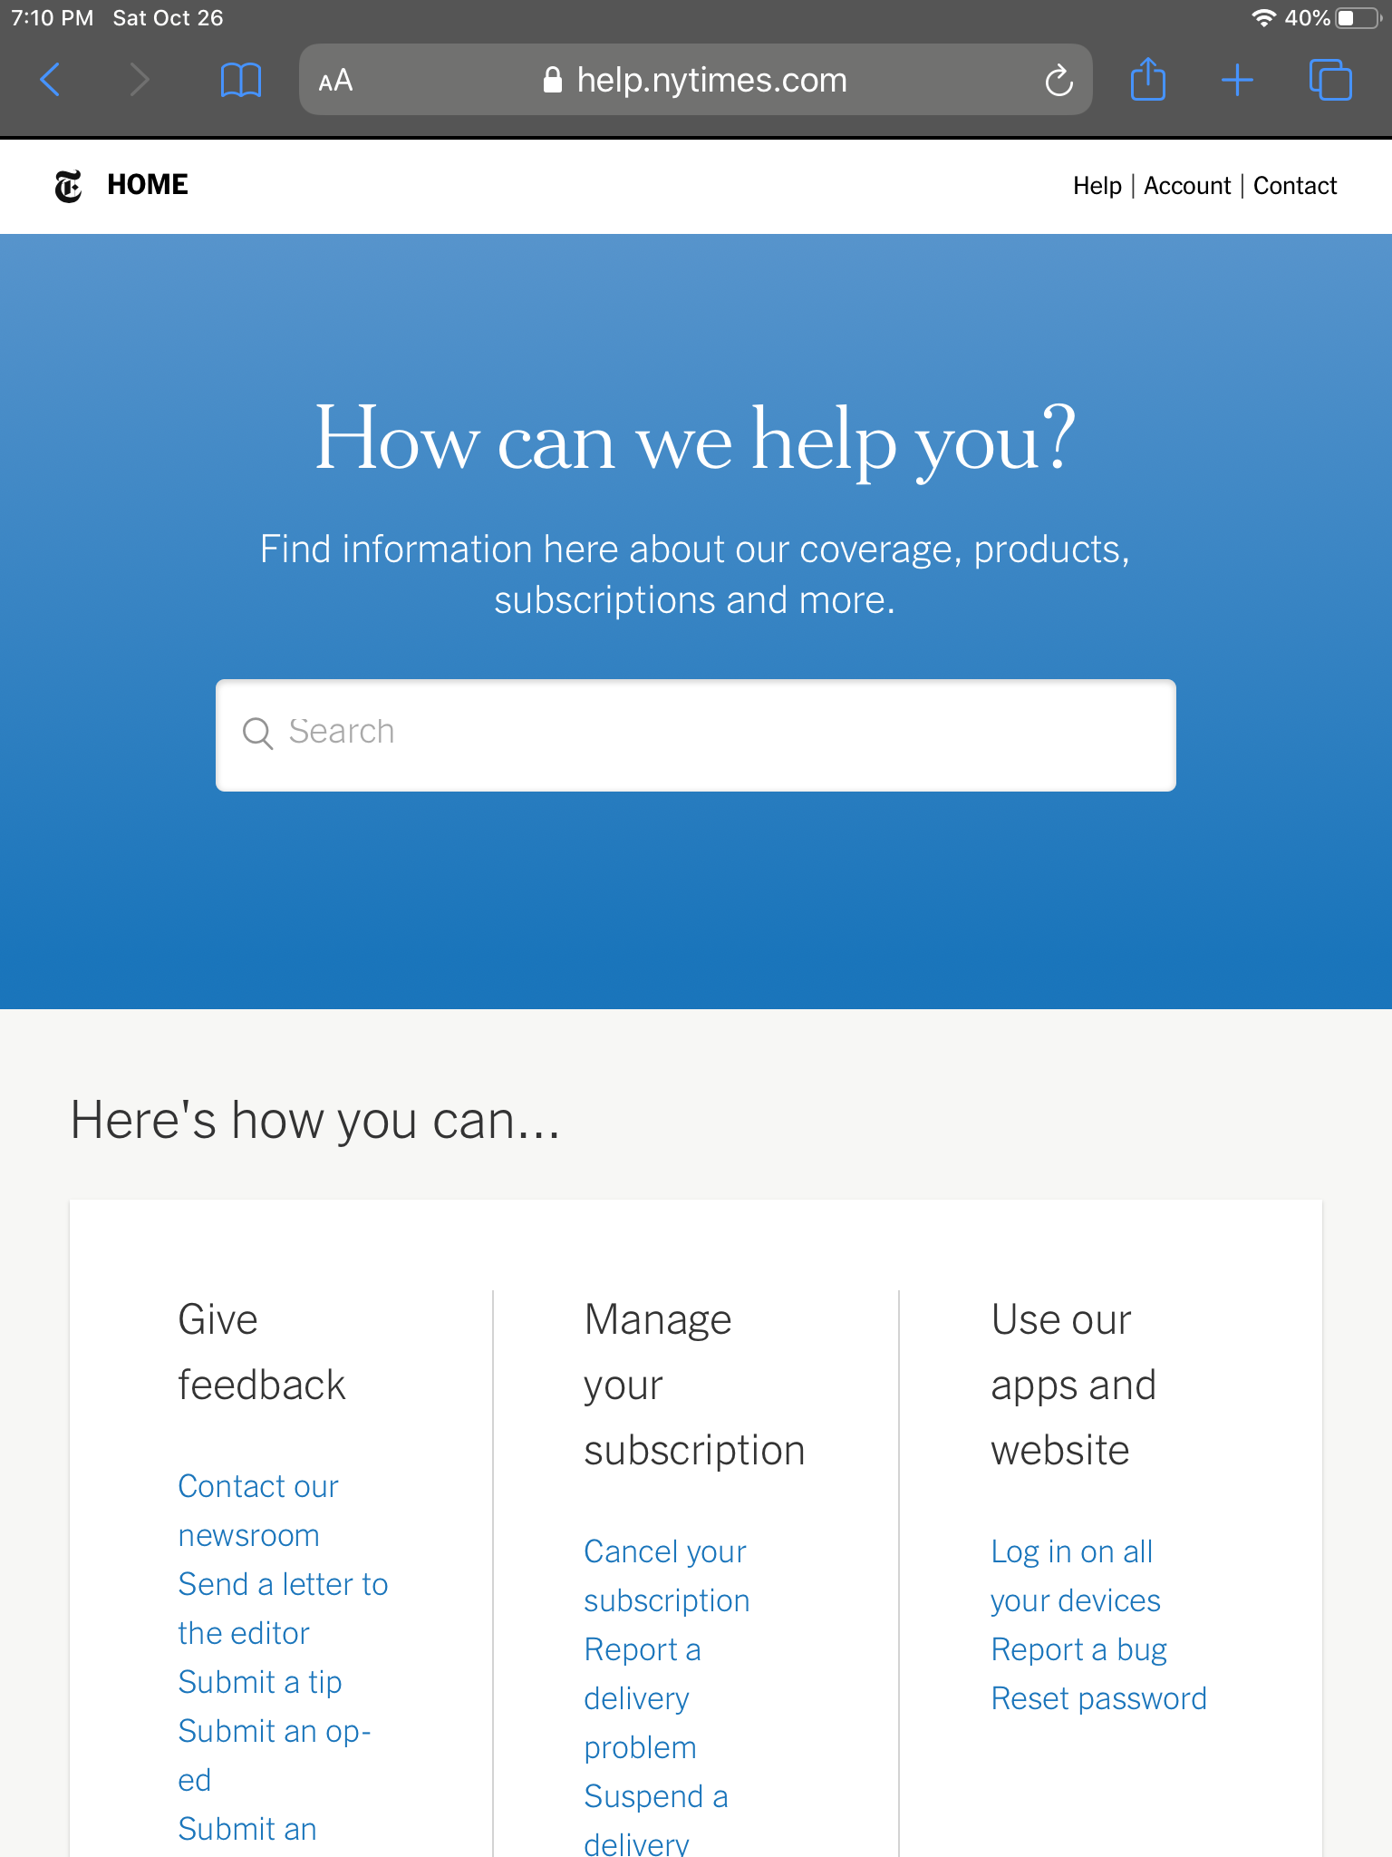
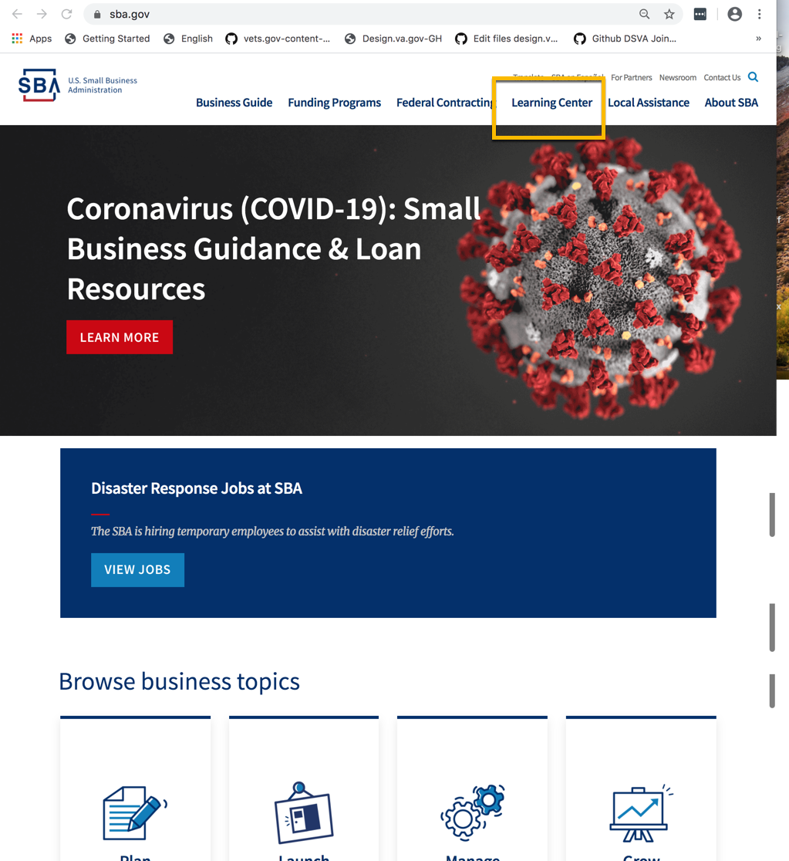
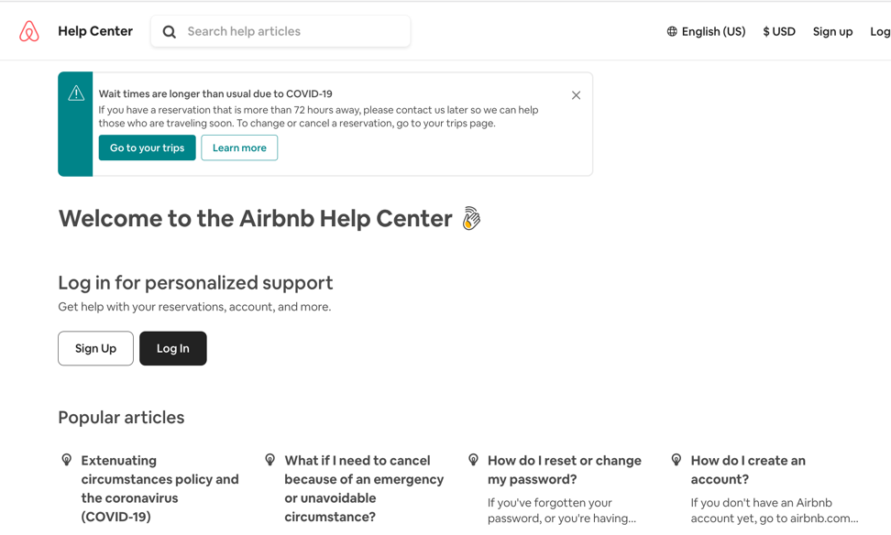
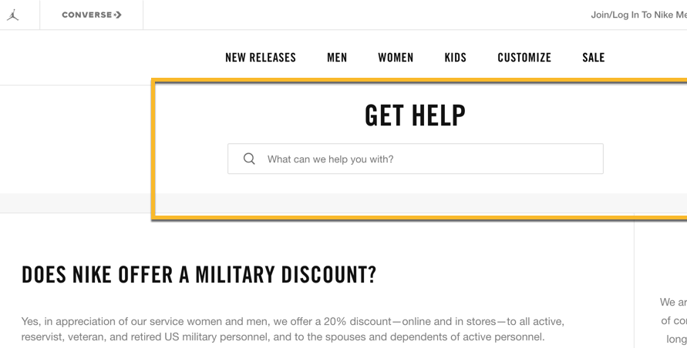
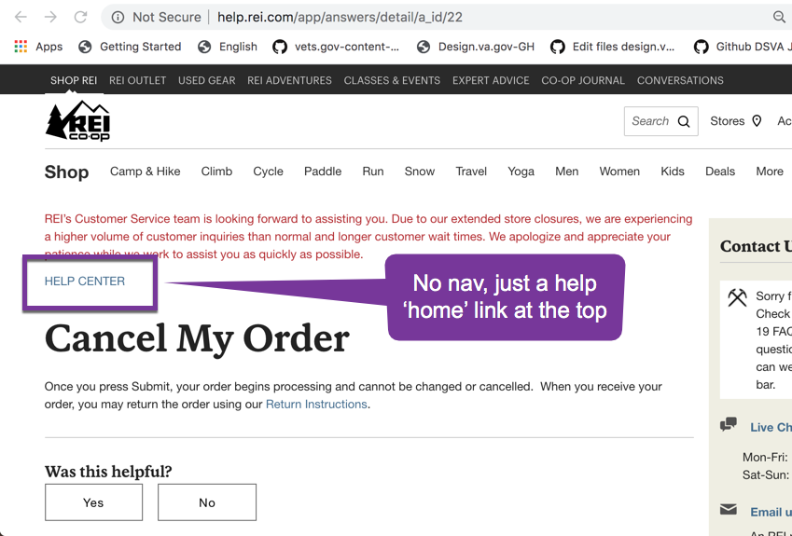
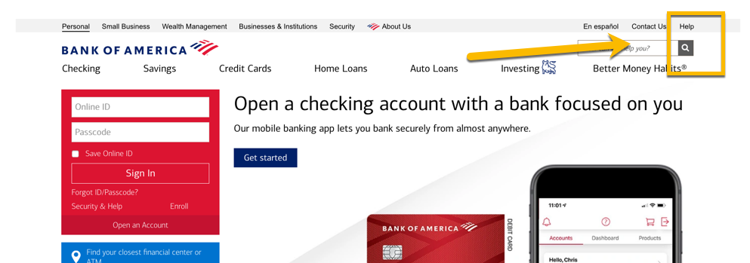
What’s in a name: Most agencies and private sector sites call it…

Slide 27
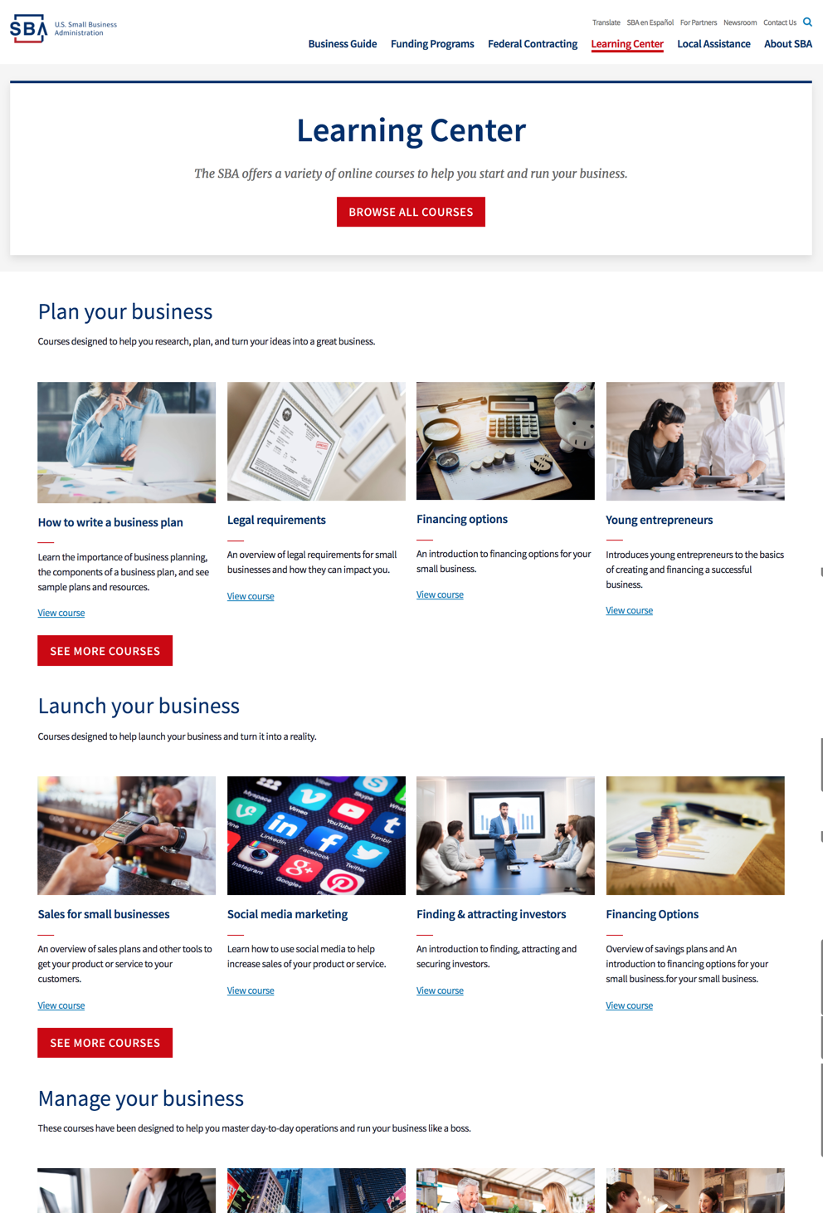
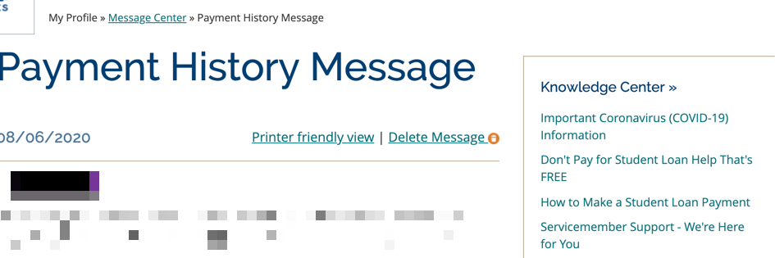
Use some variation of…
Help
Learning center
Knowledge center
Resources
Support
Notes:
Screenshot: Small Business Administration sba.gov site

Slide 28
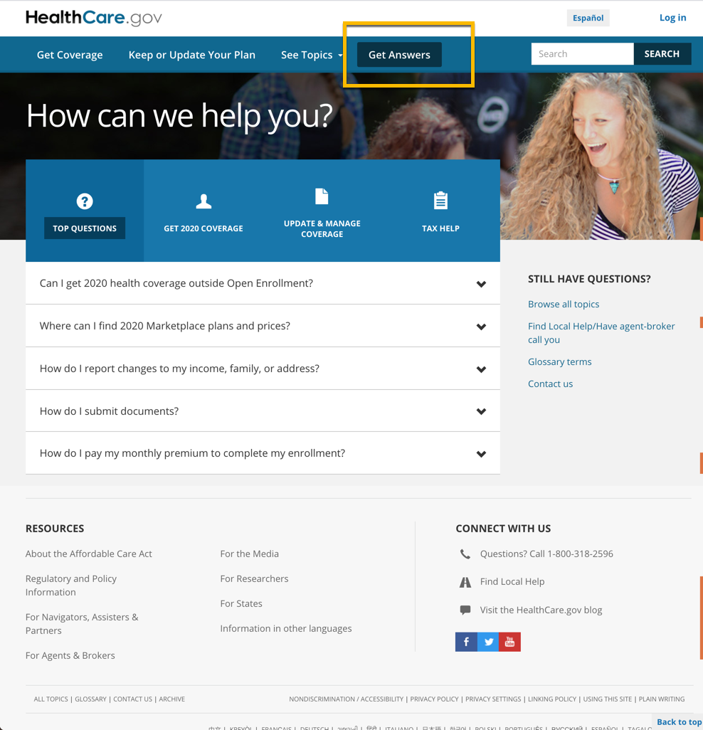
Healthcare.gov exception
On landing on the homepage, there’s no indicator of a resource/knowledge/learning/ help/FAQs/support section.
Expanding the See Topics menu yields no result.
By chance, clicked on Get Answers (not knowing what it meant). (This leads you to their FAQs section–their help/knowledge content.)

Slide 29
Key take away: What’s in a name?
Whatever you call it, use one of the commonly used labels or a close variation.
People have digital lives beyond VA.gov. They’re likely to already associate commonly seen nomenclature with this content type for product support/learning information.
Don’t brand it. Don’t be unique. Don’t be an outlier.

Slide 30
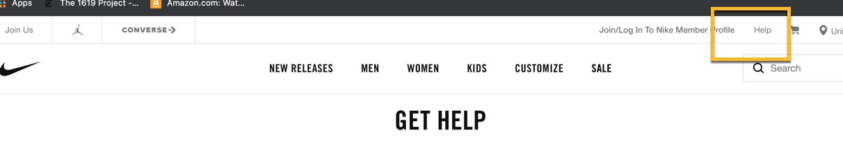

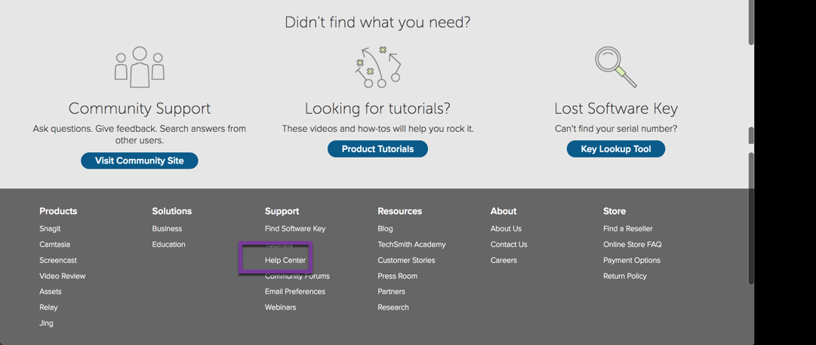


Where should it go: Many sites link to it from the global header, footer, or both

Slide 31
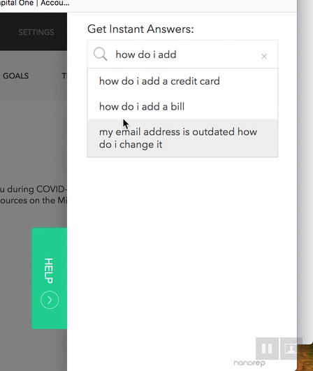
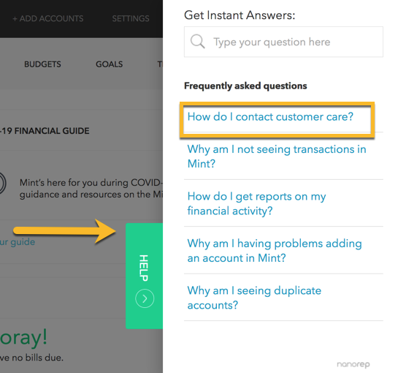
One used a fly-out tab with contextual links and type-ahead search, in addition to header and footer access links

Slide 32
Key take away: Where should it go?
Based on common web practices, people will expect to find access paths to this type of information from the global header, footer, or both.
It could also be helpful to provide contextual content access points in unauthenticated and authenticated product experiences, but only if it’s truly relevant and related information.
All learning content should send people TO tier 1 benefit tools and content (eligibility, enrolling, filing, creating an account, signing in to do manage tasks).

Slide 33
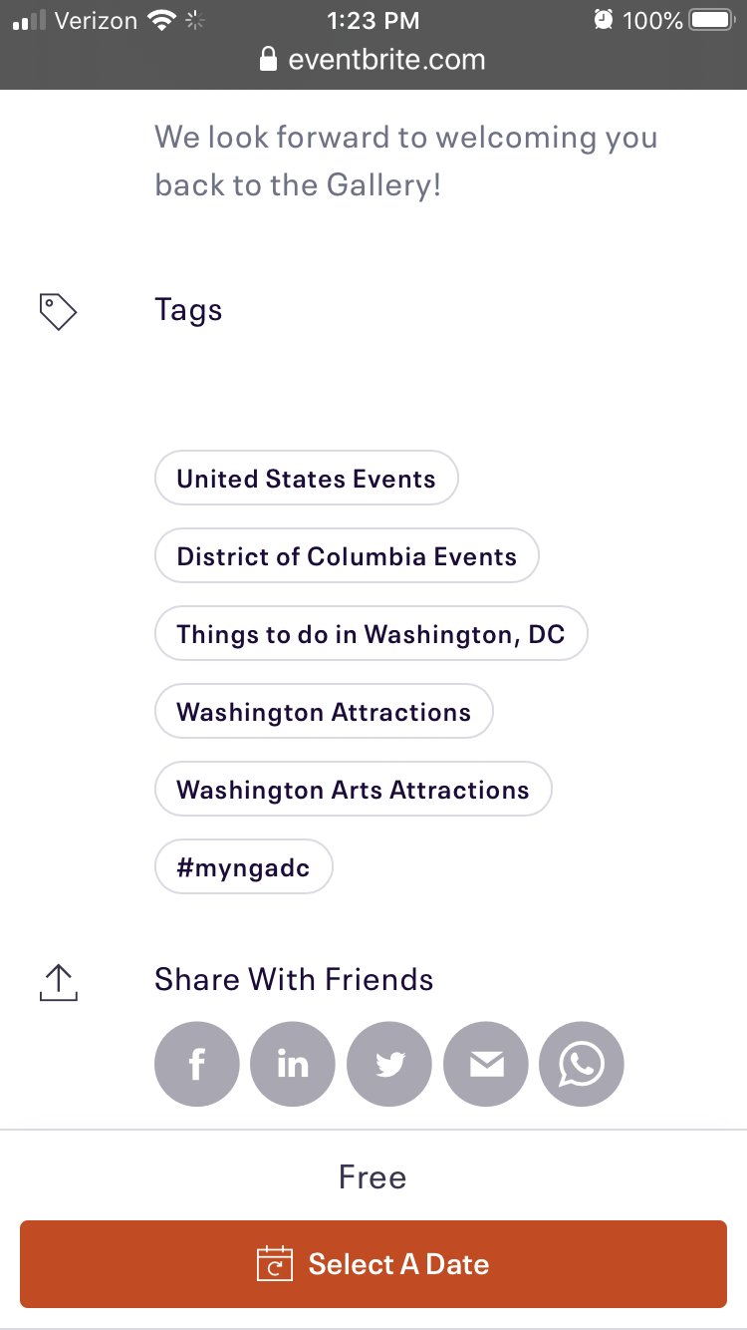
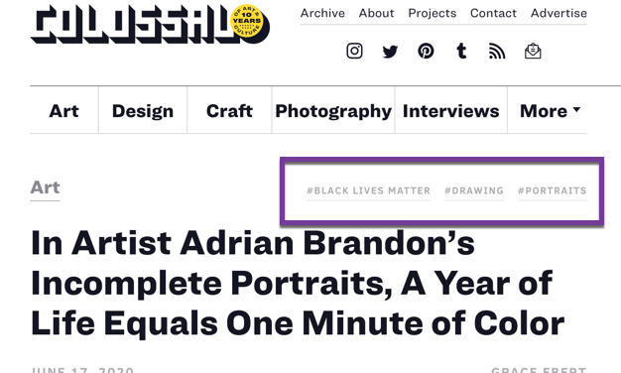
Tags: We looked at a mix of content and ecommerce sites that use tags:
Medium
Colossal
Guardian
Zappos
New Yorker
Best Buy
The Atlantic
Food52
NYT Cooking
Barefoot Contessa
Good Eggs
Great Lakes (student loan servicer)
REI
Cook’s Illustrated
Eventbrite
And others
Notes:
In this example: Local and Certified Organic are not global IA/nav labels. Clicking on Local doesn’t take you to more “local” carrot products or even more “local” produce, but EVERYTHING tagged “local,” from meal kits to meat to packaged snacks to alcohol. Everything and anything sold on the site tagged “local.”

Slide 34
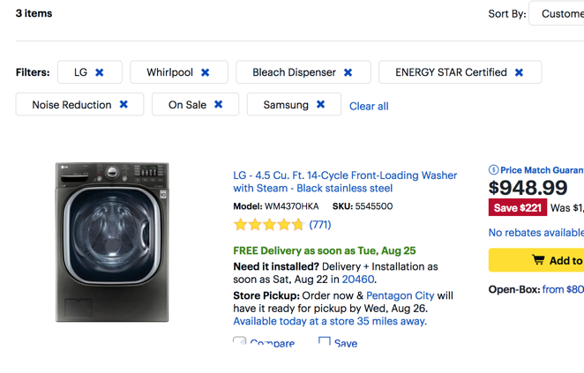
Content sites and ecommerce sites use tags differently
Content sites use tags as standalone/new search – simply another way to browse.
Ecommerce sites use tags in a more complex way, as faceted or layered search.
Notes:
Faceted filter tags can expand and narrow, and generally work within a given IA. Example: the “On Sale” tag narrows down results. But brand labels expand results. Both stay within the product category of “Washing Machines” in the IA.

Slide 35
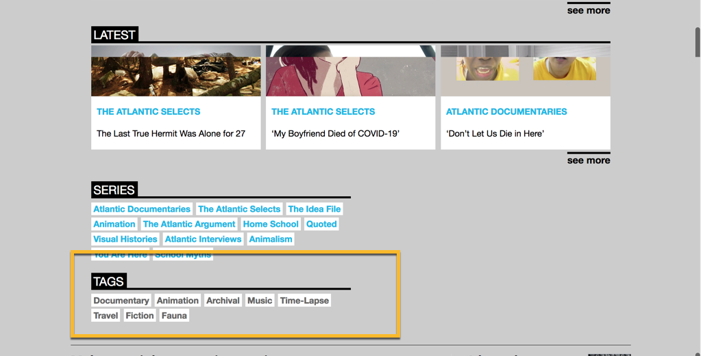
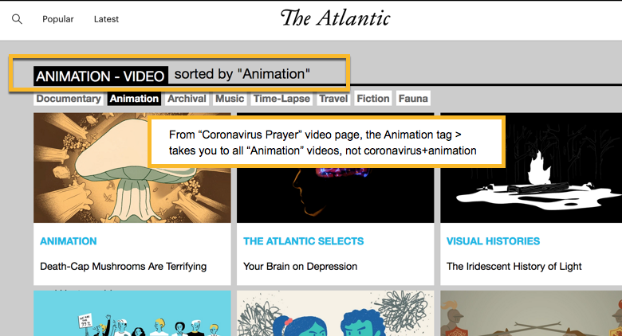
Content sites use tags as single filters, like a new search
Notes:
Atlantic example: Tags (series and tags) are independent of nav, menu and IA. Clicking on one acts as a new ‘search’ or standalone filter.

Slide 36
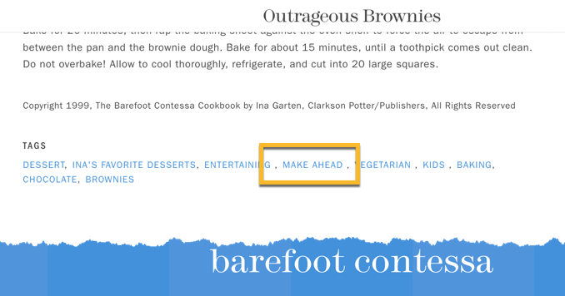
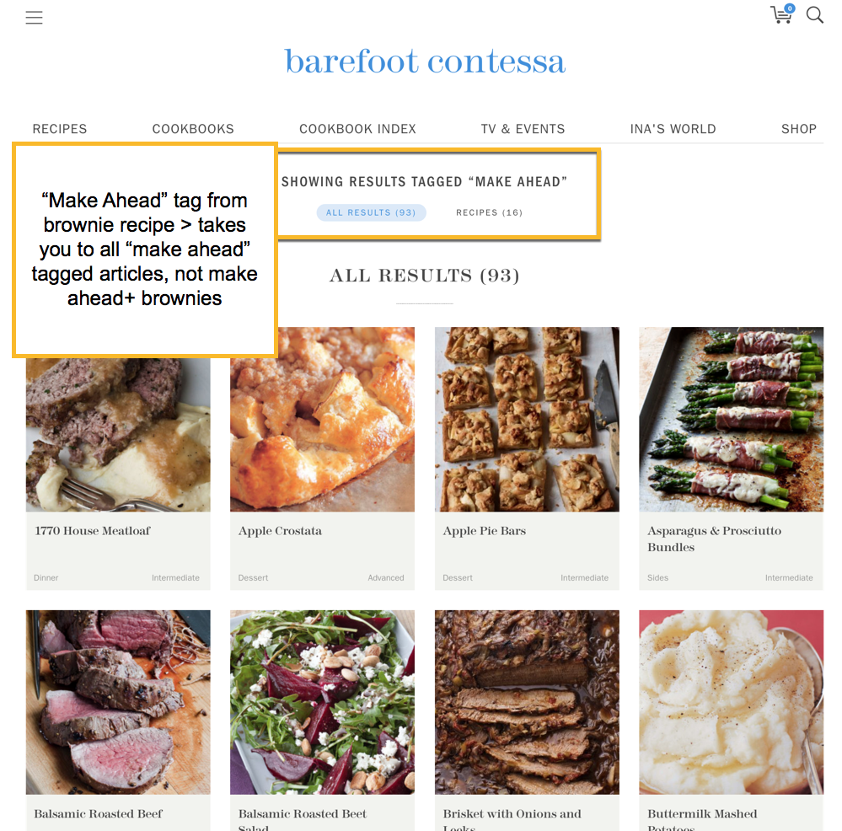
From a brownie recipe, clicking the “Kids” tag…
Takes you to all “Kids” tagged recipes
Not only brownie recipes tagged “Kids.”

Slide 37
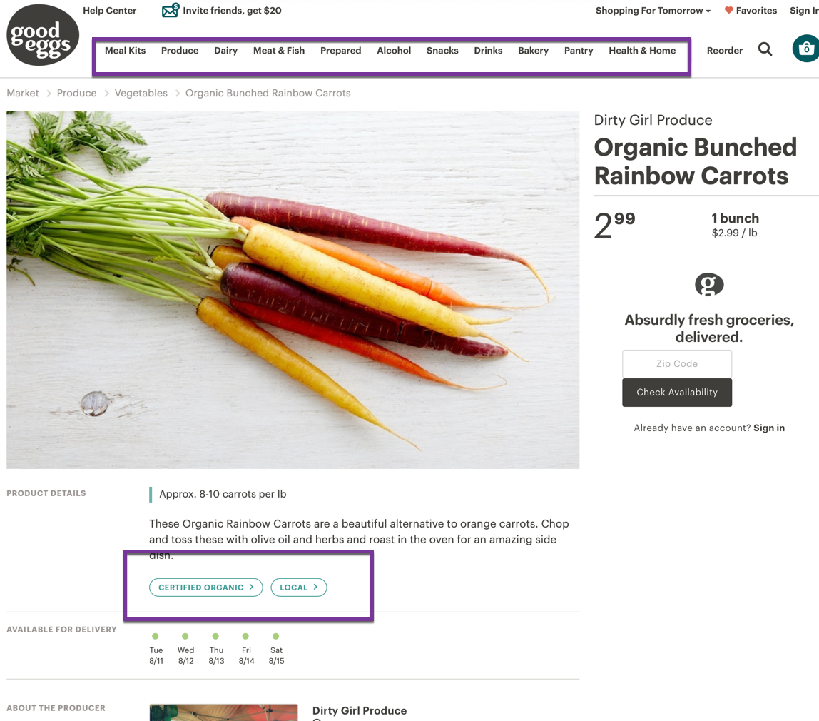
Some retail sites also use tags like content tags .
Tl;dr: Simple is okay.
Notes:
In this example: Local and Certified Organic are not global IA/nav labels. Clicking on Local doesn’t take you to more “local” carrot products or even more “local” produce, but EVERYTHING tagged “local,” from meal kits to meat to packaged snacks to alcohol. Everything and anything sold on the site tagged “local.”

Slide 38
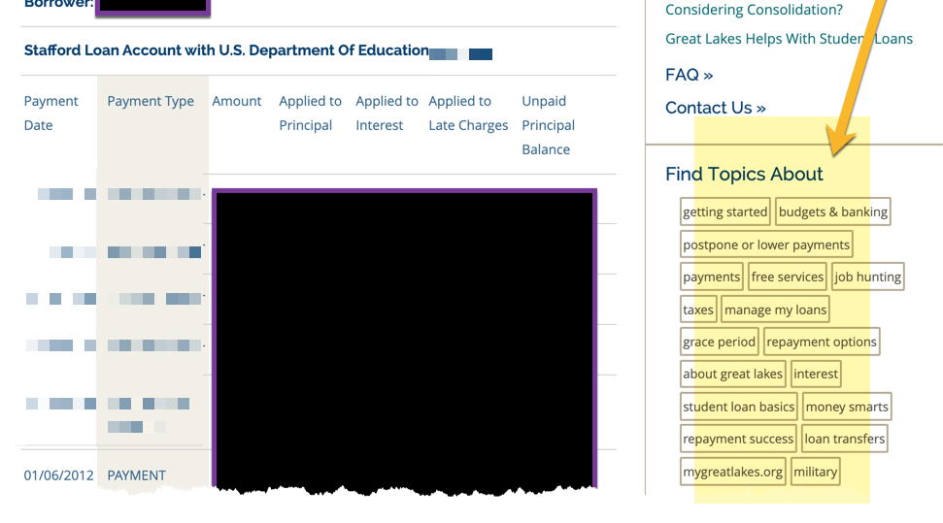
Key take away: Tags are not IA, nav, or global menu
They are another way for people to browse info, using their mental model rather than our official taxonomy.

Slide 39
Learning center tags are an experiment: FE tags + BE categories
VA content is not fun.
Can we adapt content UX from ‘fun’ content sites where engagement is a top objective – in order to:
Encourage Veterans to explore their VA services?
Make VA.gov the source of VA information (rather than military.com and other top ranked competitive sites)?
Hypothesis – FE tags: Adapting similar content UX will encourage Veterans to browse, explore, and discover content they otherwise wouldn’t.

Slide 40
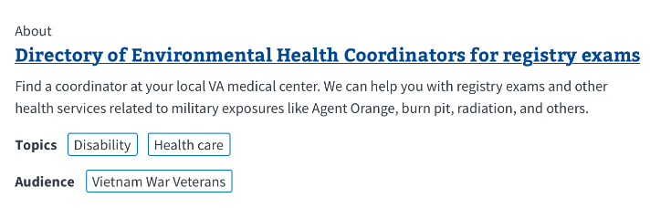
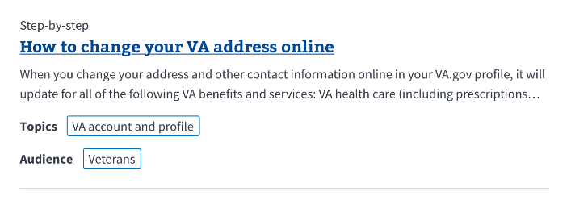
Start simple
LC will start with a basic MVP set of tags, based on existing benefit labels and audience groups already used on VHA, VBA, and NCA legacy websites.
We will use LC search data and call center data to inform future tags.
And if we find that people don’t interact with tags that much, we’ll deprecate them.
Notes:
Example: if we find a pattern of high LC search queries on “claim status” or “compensation” or “appeals” – we could create new tags for those terms and make relevant content more findable

Slide 41
5. Design and function

Slide 42
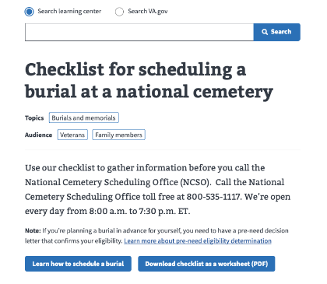
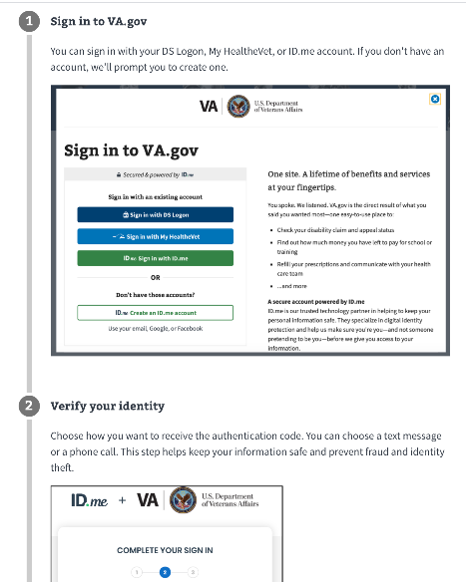
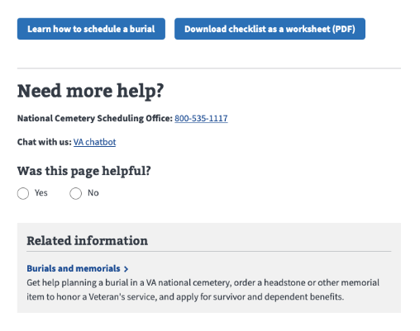
Structured content
Top layer:
Search bar
H1 article title
Tags
Intro text
Up to 2 CTAs
Middle layer
Structured body content (checklist/FAQs, etc.)
Bottom layer:
Optional repeat of CTAs
Contact us/Need more help
Was this helpful
Related articles and other deep content
Default dedicated VA benefit hub component

Slide 43
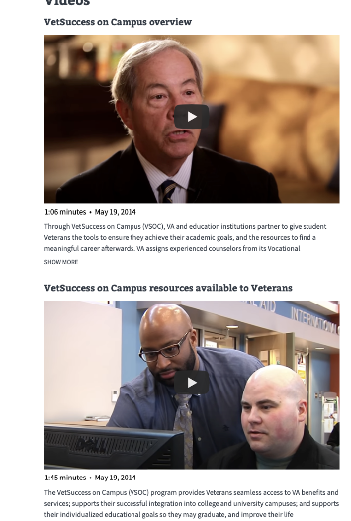
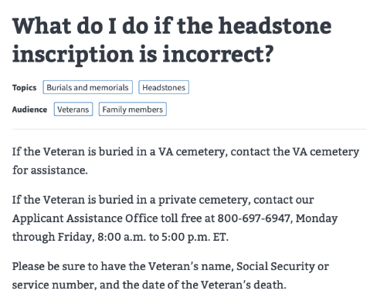
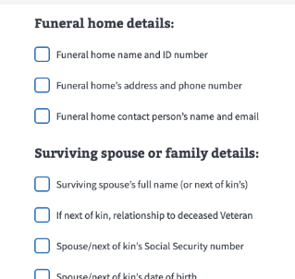
Middle layer
Rigid CMS experience – no ad hoc customization. Authors pick a template and fill in the fields.
Question and answer (pulled from reusable FAQs library)
Multiple FAQs (pulled from reusable FAQs library)
Step-by-step with screenshots
Checklist
Image list
Videos
About

Slide 44
Some of the functionalities
Reusable FAQs library: COPE (create once, publish everywhere)
Ability to select multiple backend categorization
Example: ‘How to change your address’ articles can be categorized according to the official IA taxonomy AND Veterans’ conditioned expectations.
Hypothesis: Backend categorization will allow us to make articles findable in multiple LC categories based on user’s mental model, even if it doesn’t map to our official taxonomy.
Was this page helpful data captured in GA

Slide 45

Making something real is hard.
It takes guts.
It takes navigating uncertainty and lots of
changes, especially in an agile iterative model.
You are builders and makers. Kudos to you all.

